Slide 1
Case Study 2: Lending Club
Team 4: Emily Strong & Raksha Kaverappa

Slide 2
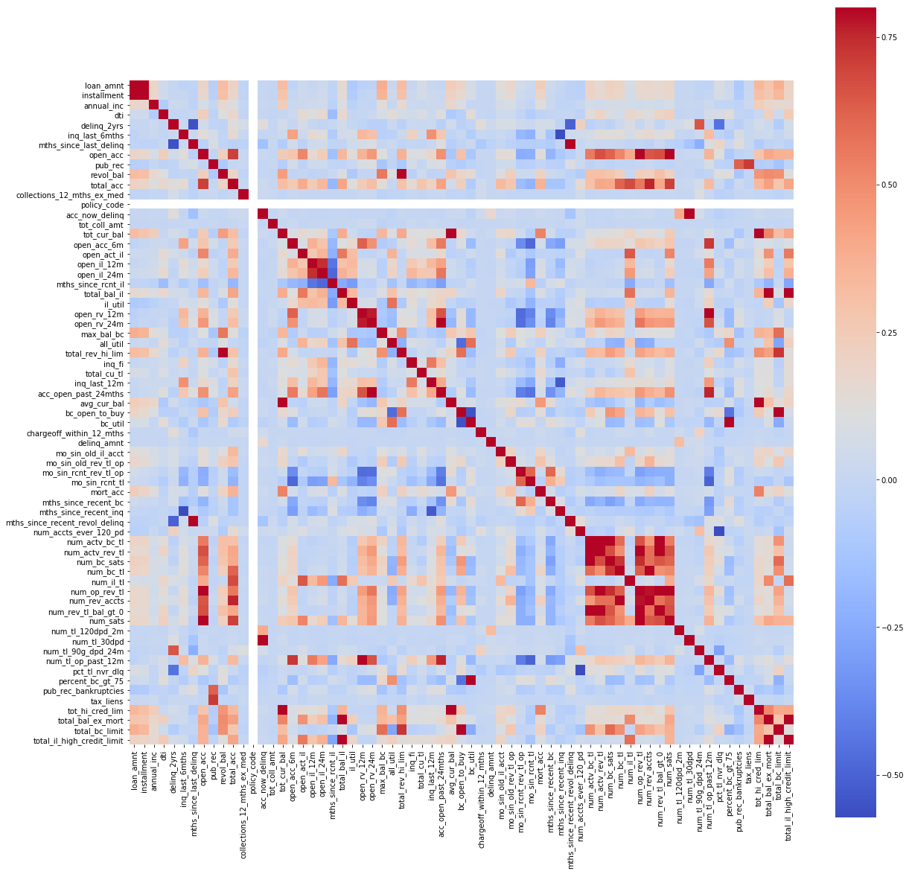
Data Wrangling

Slide 3
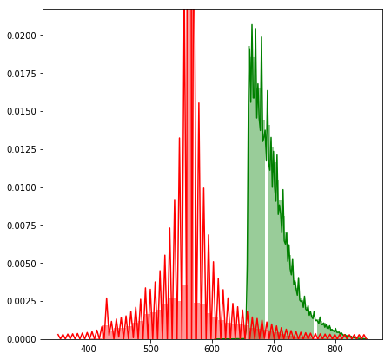
Loan Applicants: Credit Scores
Lending Club requires a minimum credit score of 660 to be approved. Plotting credit scores for declined (red) versus approved (green) loans shows this cutoff.

Slide 4
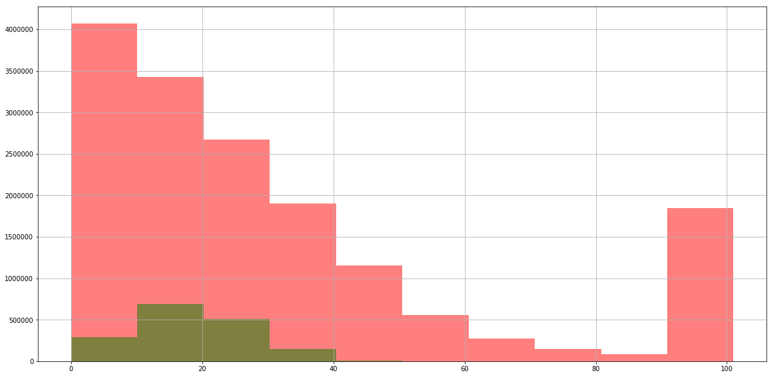
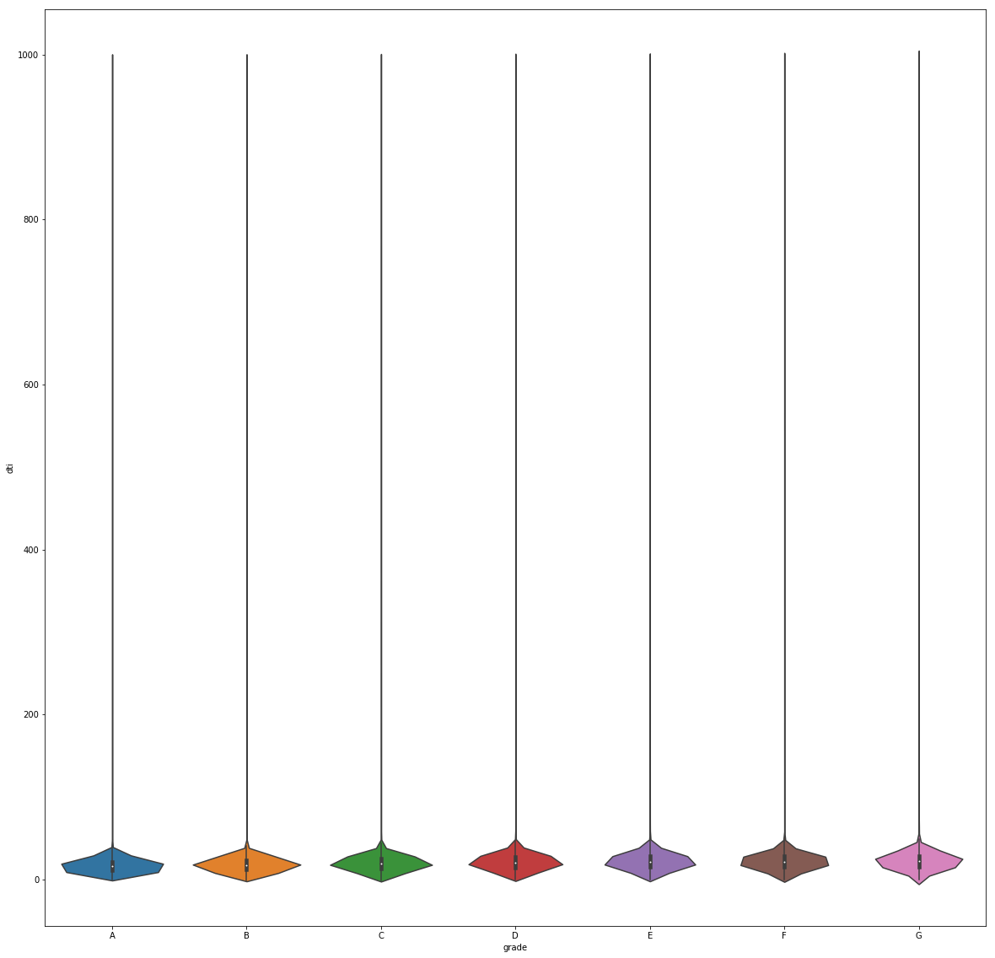
Who Applied: Debt-To-Income Ratio
There is also a maximum debt-to-income ratio of 40% to be approved. There are exceptions however, as a plot of just DTI for approved loans shows.
DTI All Loans
DTI Approved Loans by Grade

Slide 5
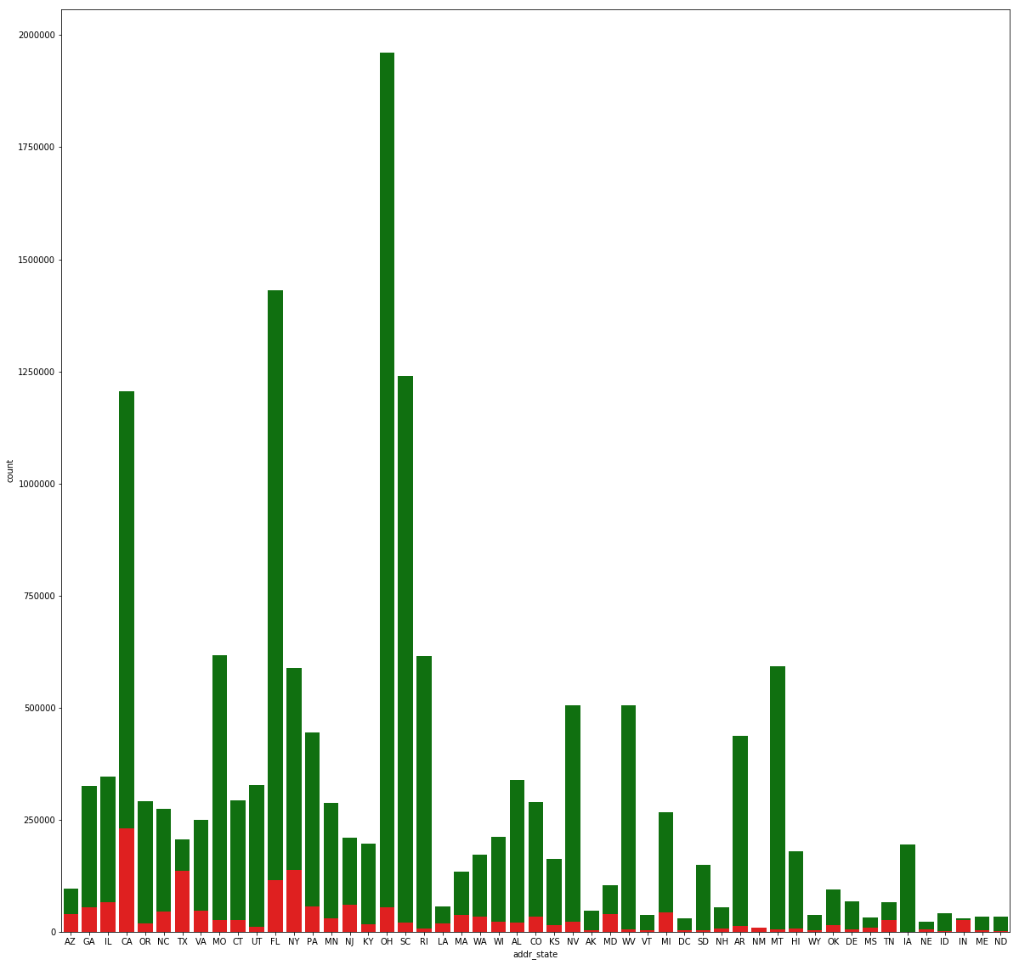
Who Applied: State Residency

Slide 6
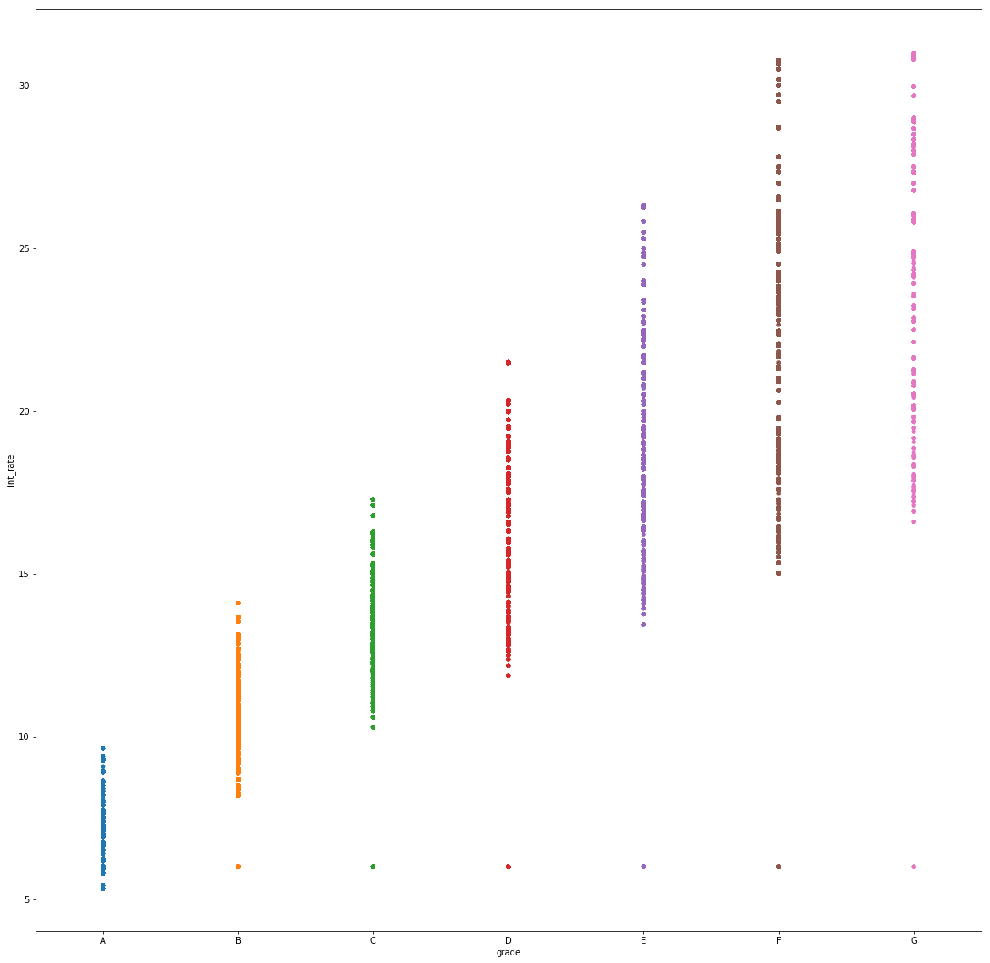
Interest Rate Clustering
Lending Club assigns each approved loan a grade (A-G) and a sub-grade (1-5) to determine the interest rate.
Interest rates are calculated based on a base (~5%) plus a risk adjustment set using the A1-G5 sub-grade.

Slide 7
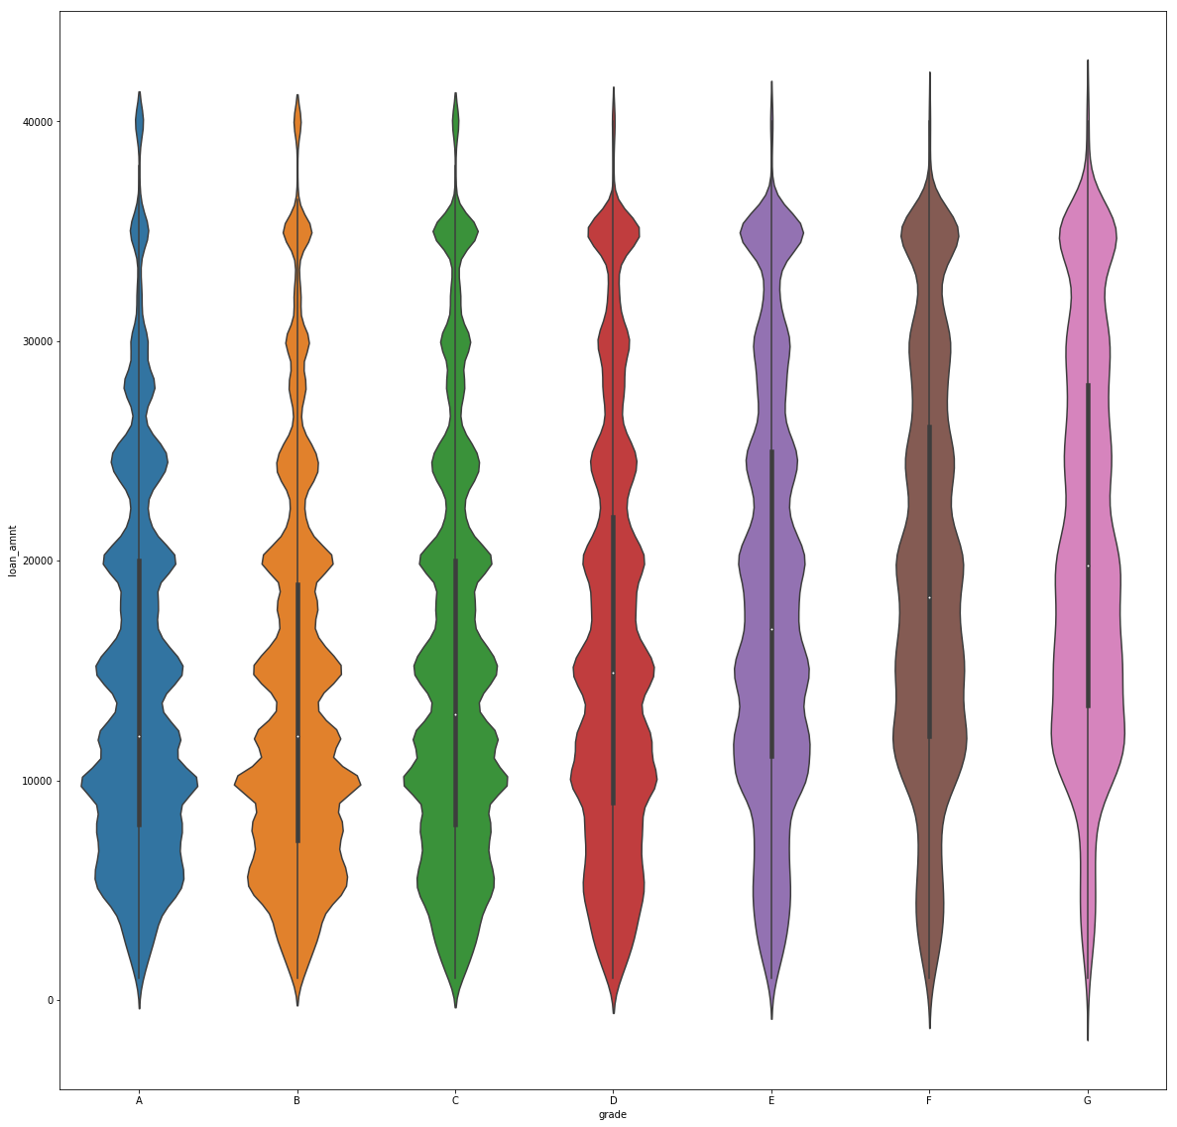
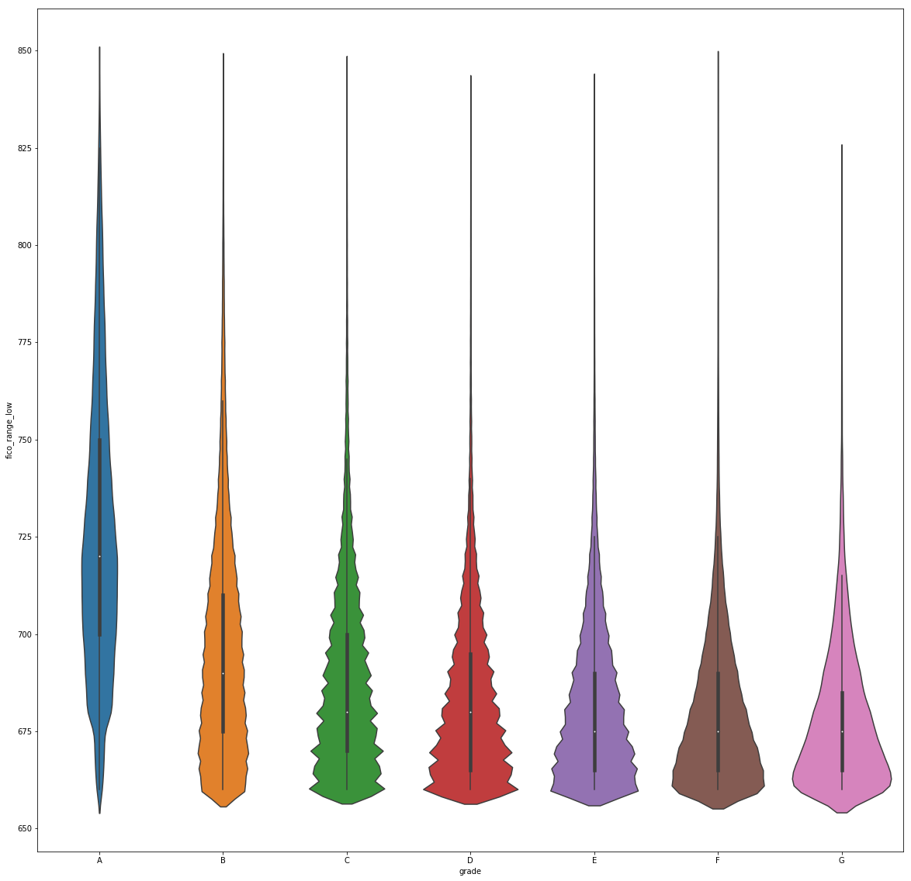
How Loans Are Clustered
Aspects of both the loan and the applicant’s credit report are factored into the grade, including loan term and amount, credit score, debt-to-income ratio, and home ownership.
Loan Amount by Grade
FICO Score by Grade

Slide 8
Classification Models

Slide 9
Classification Models

Slide 10
Clustering

Slide 11
Prediction Models

Slide 12
Prediction Models

Slide 13
Deployment

